Slide 1

Capstone Project - Blockchain Based Ticket Management
Group 2 Milestone Submission - Private Blockchain Network
Mentor - Kalpit Singh Kushwaha
Team - Pinakin Purandare, Vishal Chawre, Swaminathan, Madhavi Chopparapu

Slide 2
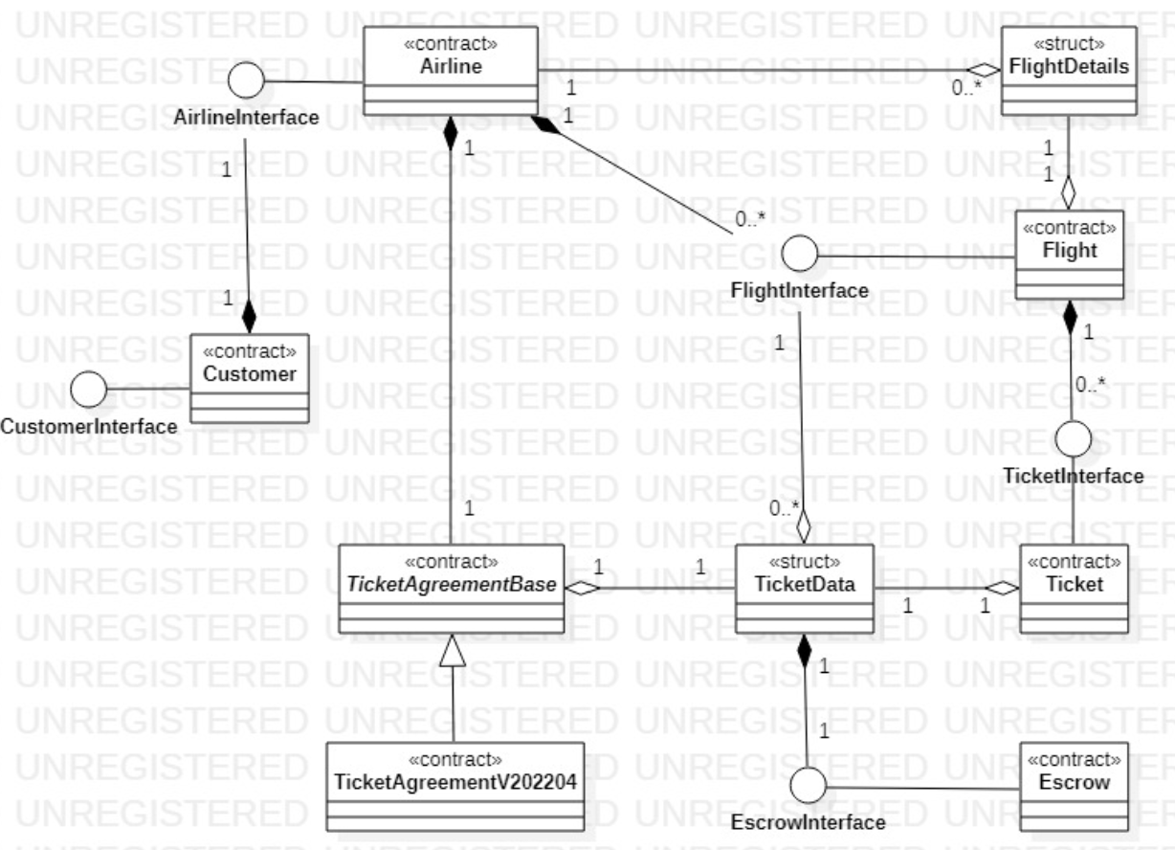
SMART Contracts

Slide 3
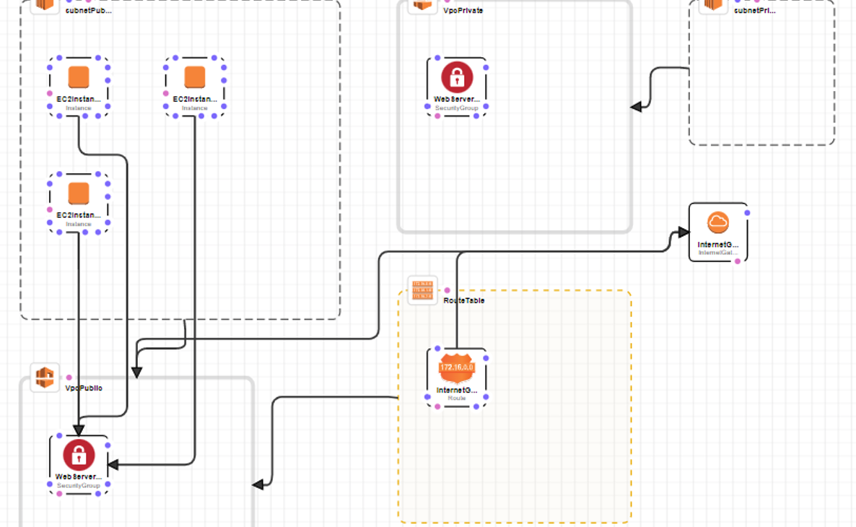
Blockchain Infra - cloud

Slide 4

Blockchain Infra - GETH
(Boot Node)
EC2 Machine 1
EC2 Machine 2
EC2 Machine 3
Vishal - Customer Account
Swami - Customer Account
Pinakin - Customer Account
Madhavi - Customer Account
EagleAccount1- Sealer Account
EagleAccount2- Sealer Account
Escrow Account
(Smart Contract)

Slide 5
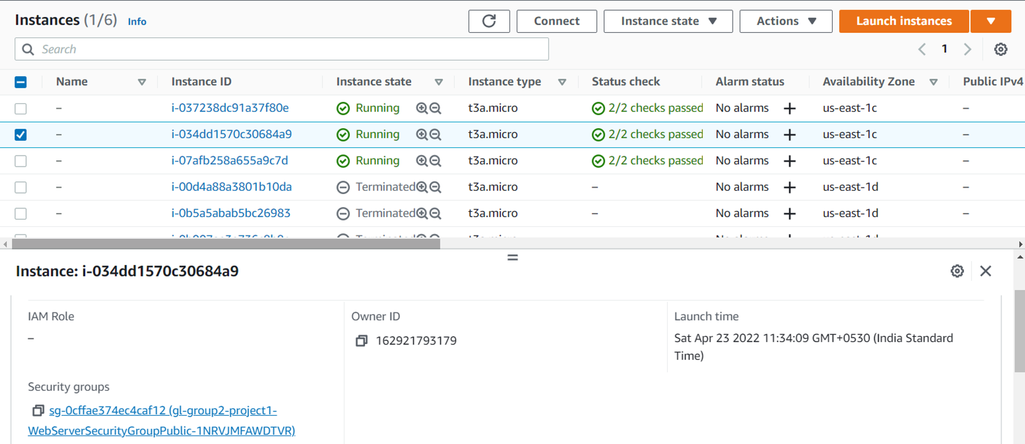
EC2 Instances – Boot and Geth Nodes

Slide 6
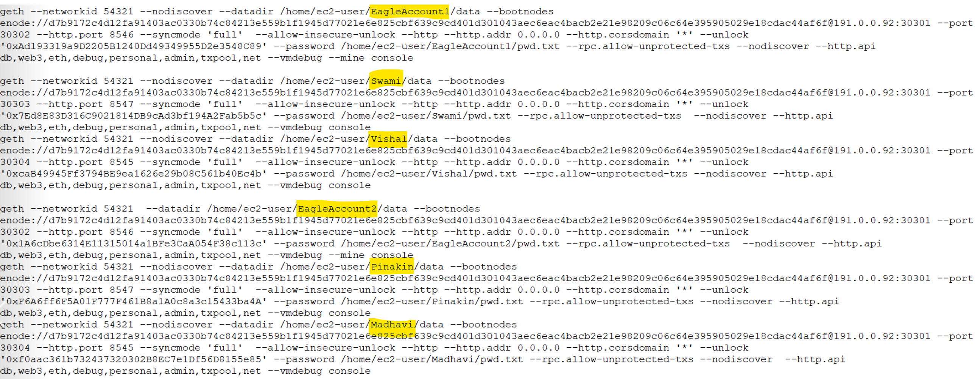
Geth Accounts start Commands

Slide 7
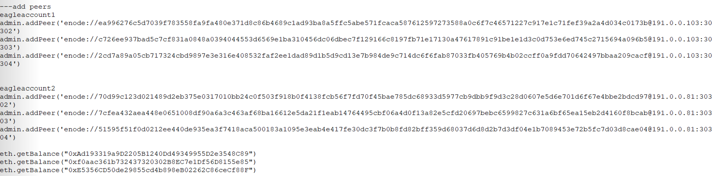
Add peers, checking balance and send txn

Slide 8
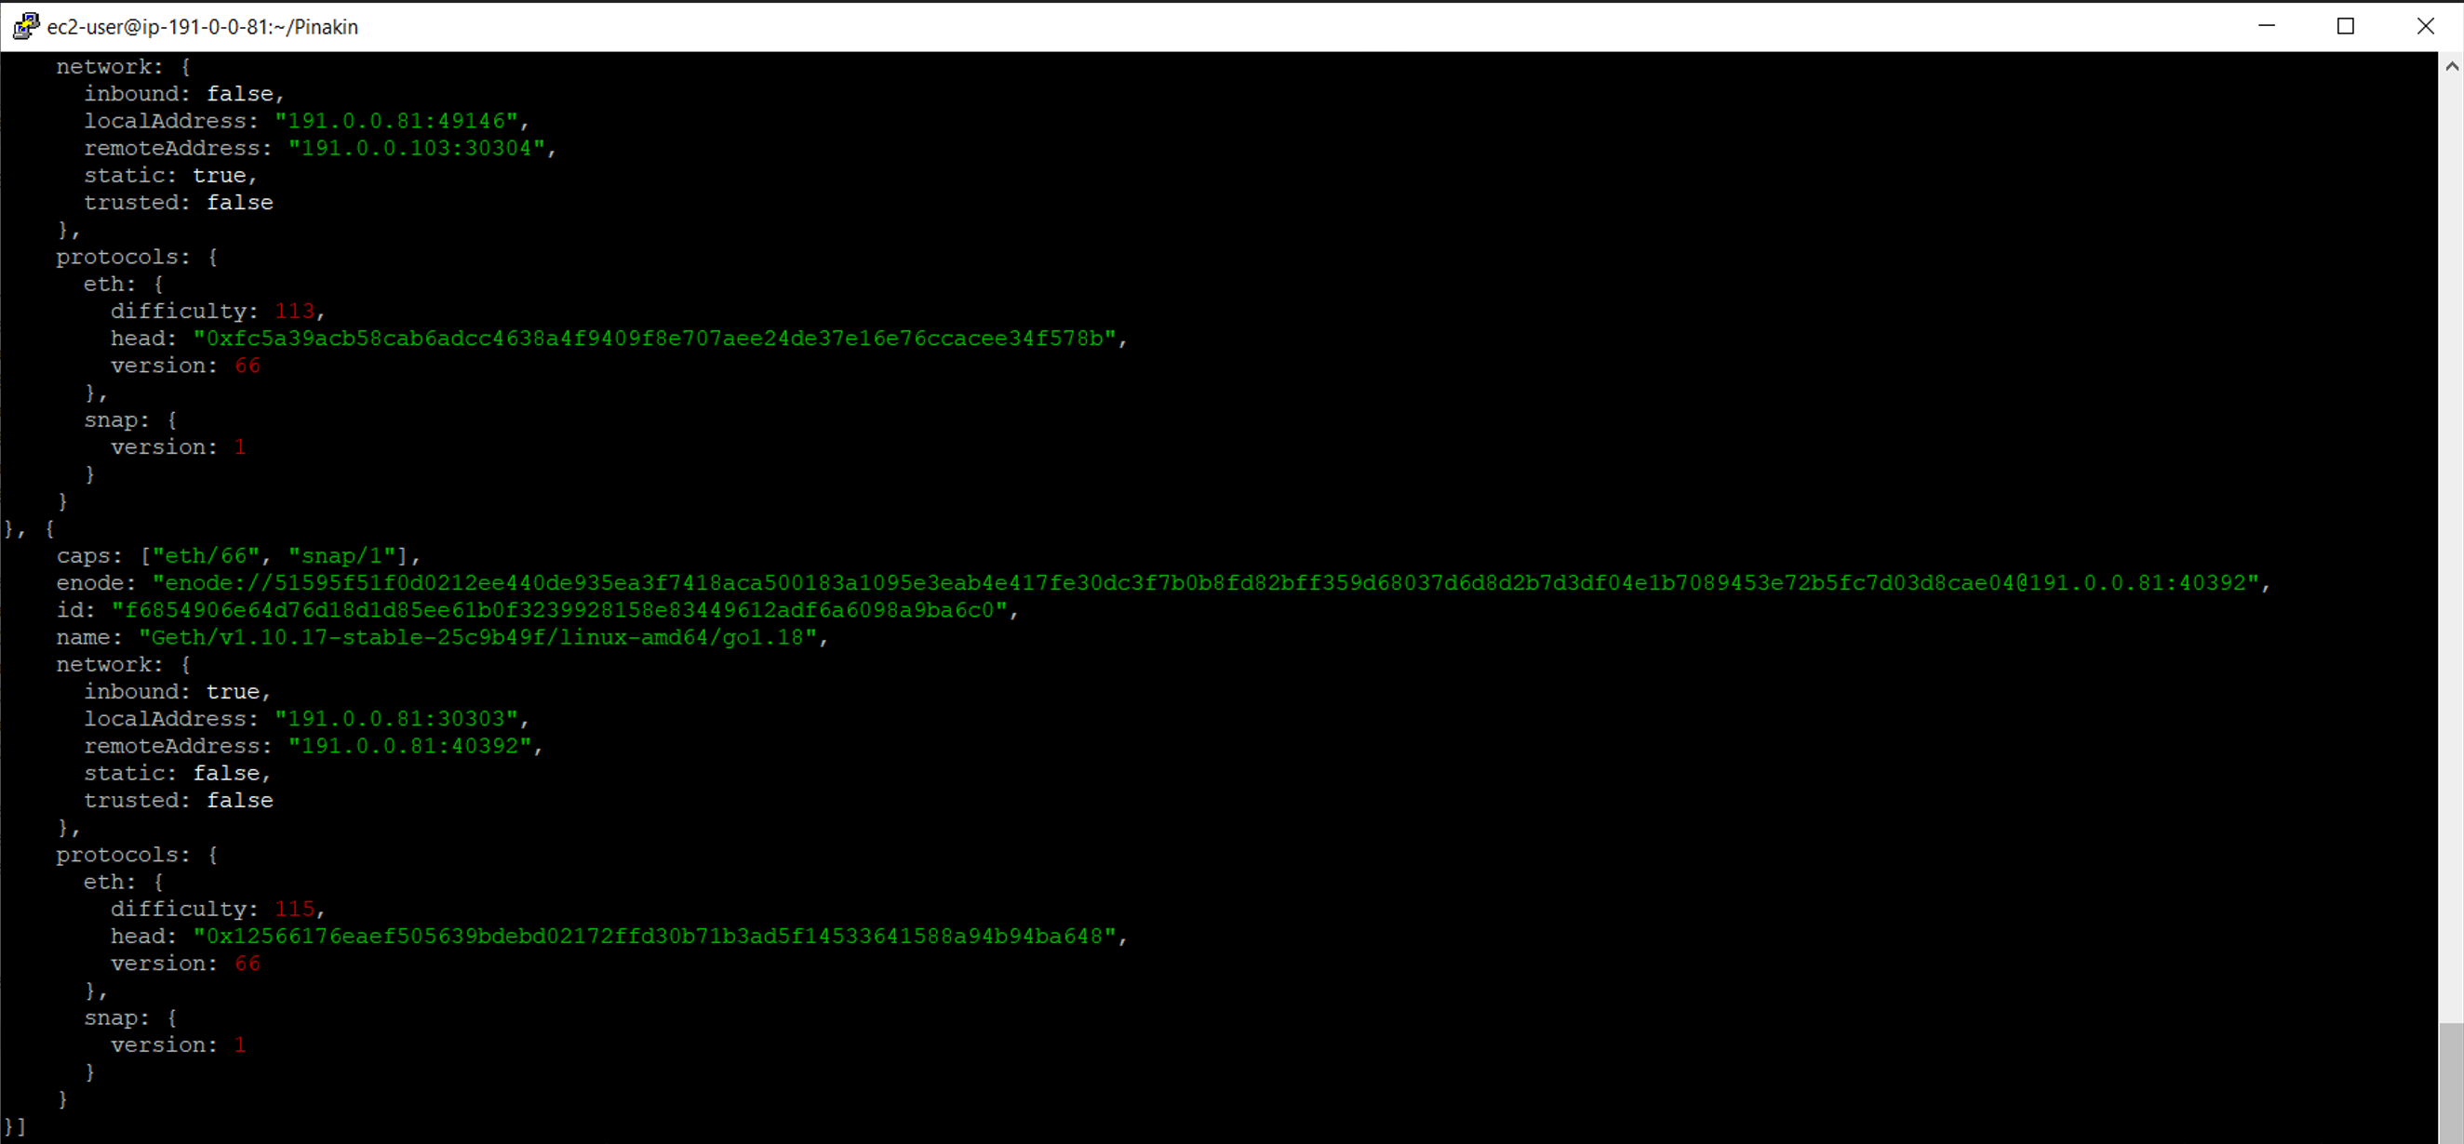
verify peers

Slide 9
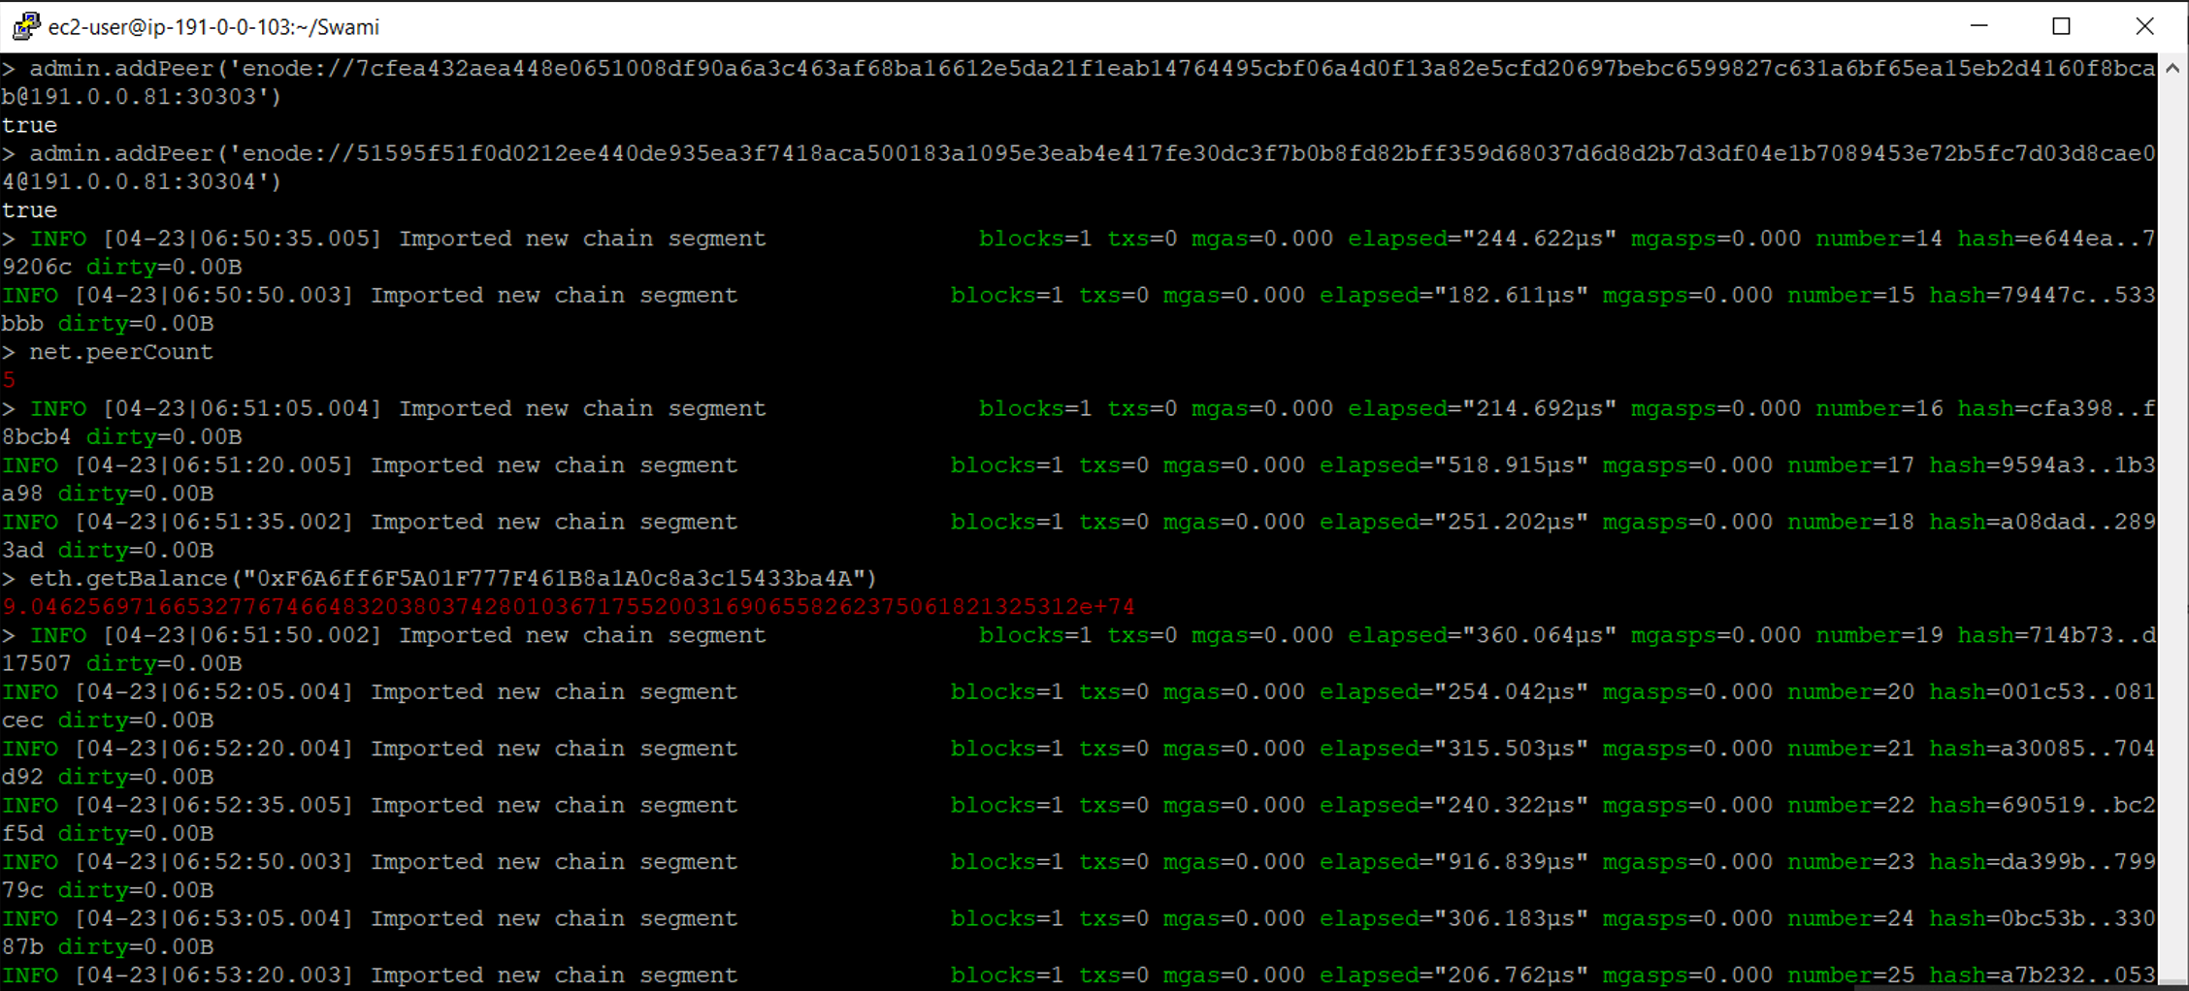
GET balance – Same Ec2 Machine

Slide 10
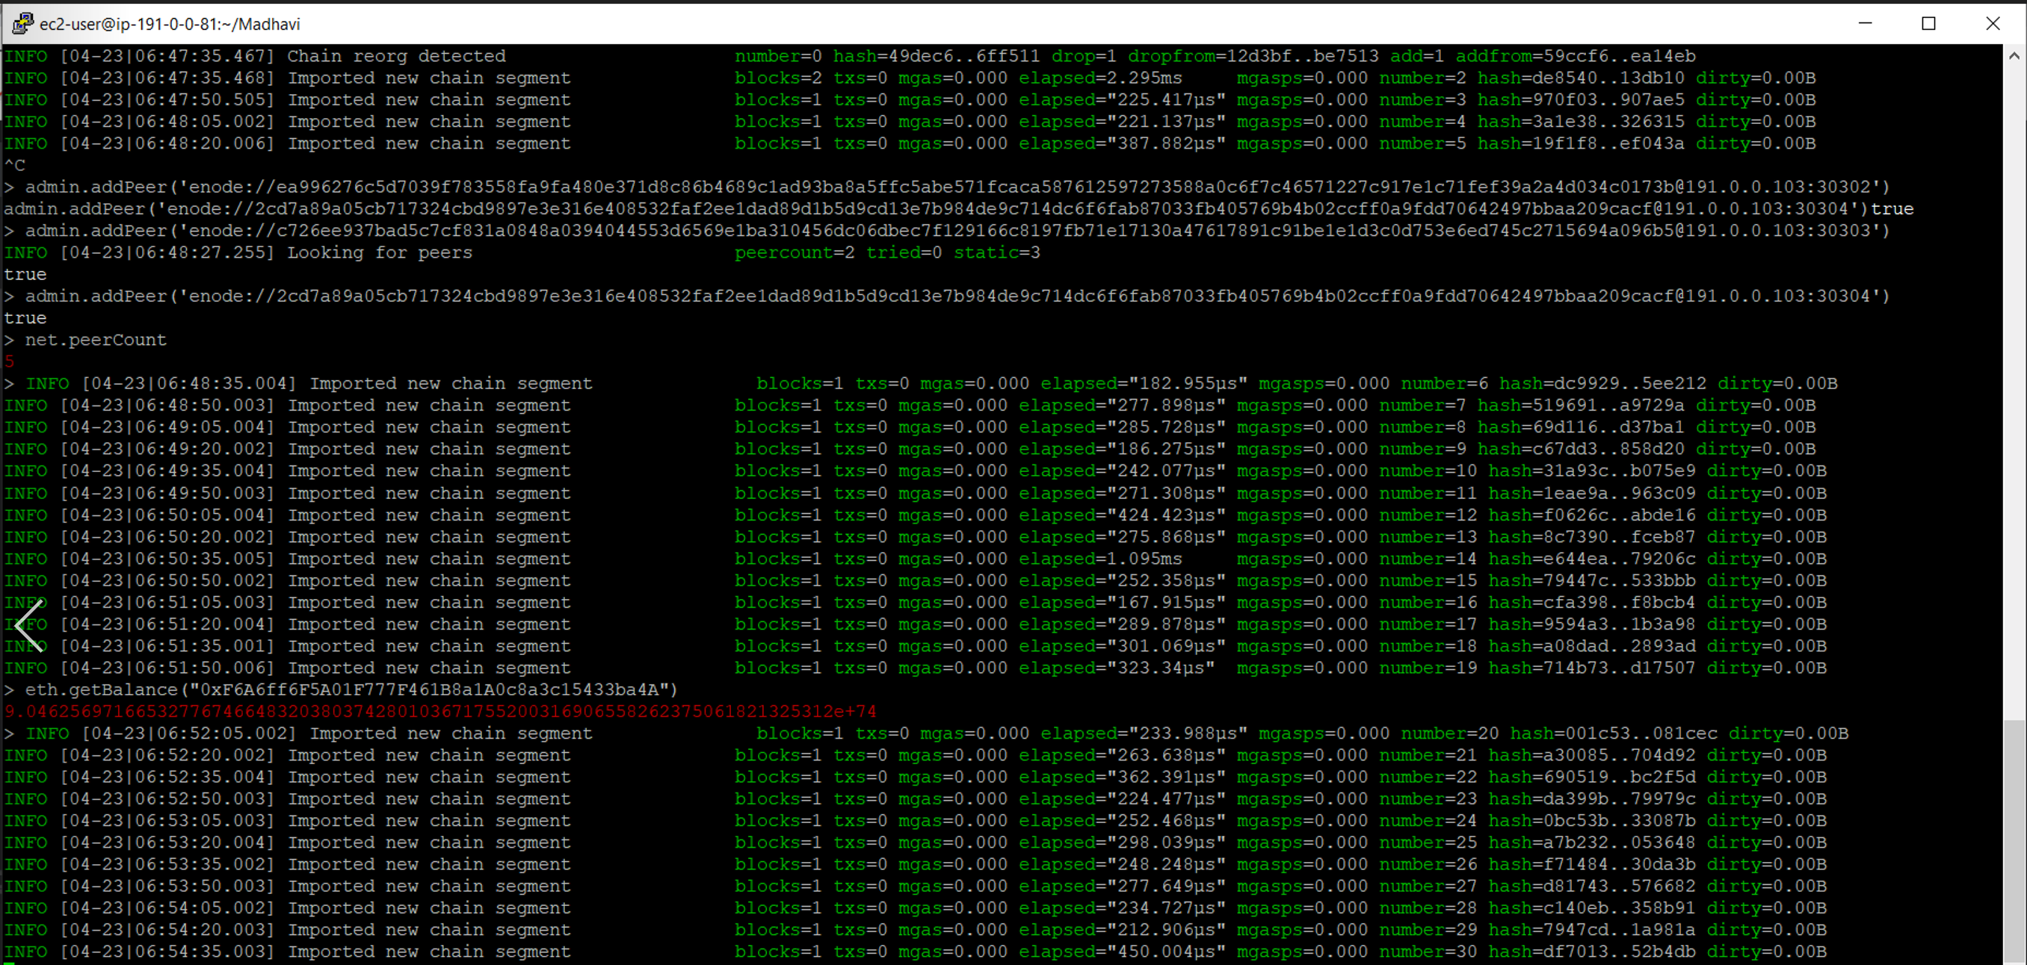
GET balance – Different Ec2 Machine

Slide 11
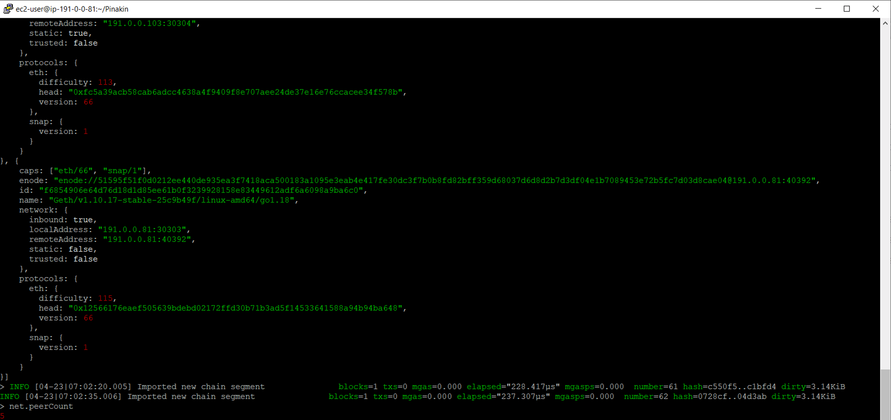
Checking Peer Count

Slide 12
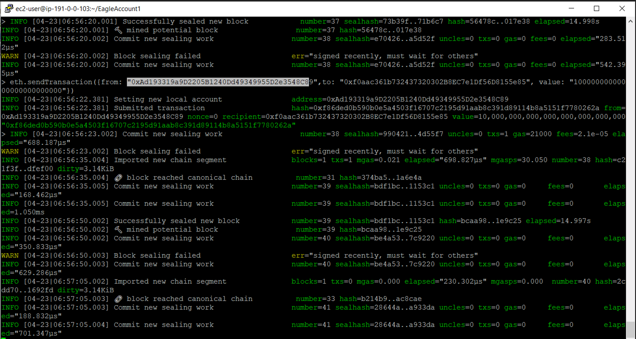
Send TxN with Different ec2 geth account
GET balance

Slide 13
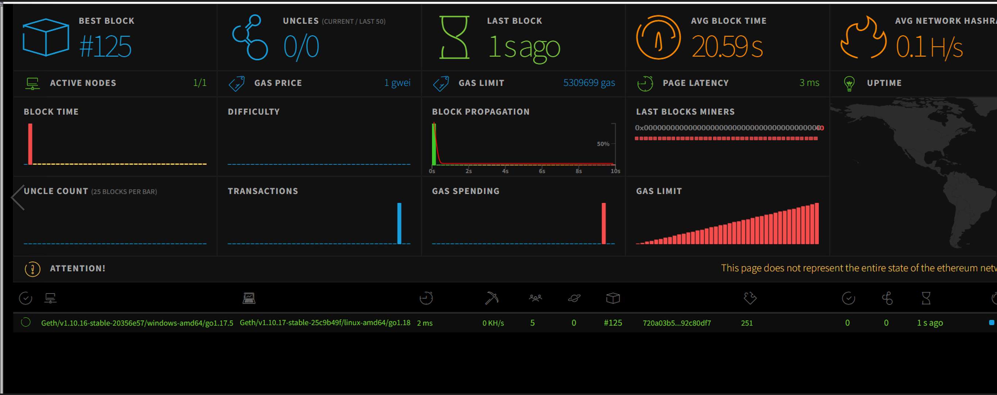
Dashboard – Blockchain Network Monitoring

Slide 14
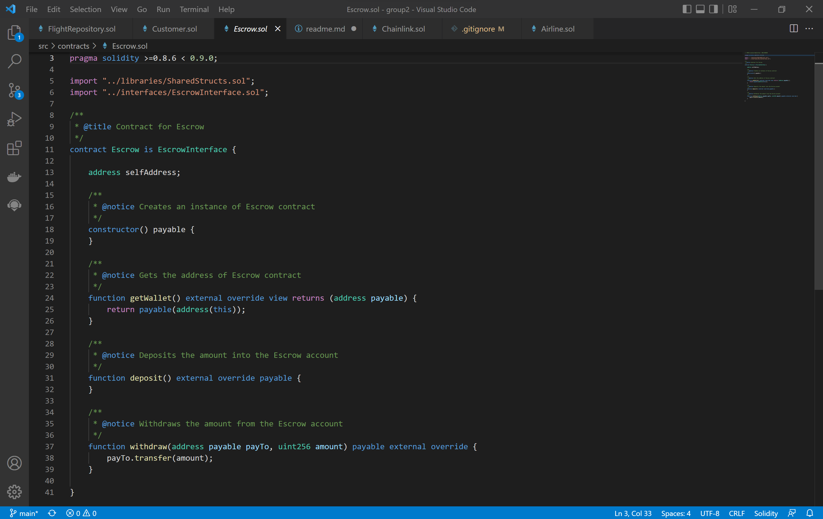
ESCROW SMART CONTRACT CODE

Slide 15
More to Come…
In Final Submission

